Slide 1
DATA LITERACY WITH TABLEAU
PROJECT TITLE:
Unveiling Market Insights: Analysing Spending Behaviour and Identifying Opportunities for Growth

Slide 2




TEAM PROFILE NM TEAM ID : NM2023TMID37268
TEAM LEADER
BHUVANESH.V
BHARATH RAJ.R ASHOK KUMAR.A ABISHEK.J

Slide 3
INTRODUCTION
INTRODUCTION
House price prediction in a metropolitan city in India is a valuable solution for potential home buyers, real estate agents, and investors. By leveraging historical sales data, property details, and location-specific information, a predictive model can accurately estimate house prices. The model's scalability, real-time updates, user-friendly interface, and transparency ensure it meets the needs of stakeholders. Integration capability, data privacy, and cost-effectiveness are also important considerations. By addressing these requirements, the prediction model provides reliable insights, empowering stakeholders to make informed decisions in the fast-paced real estate market.

Slide 4
PURPOSE
The goal is to provide a reliable and accurate prediction tool that assists users in navigating the competitive real estate market and maximizing their returns.
The model should identify the key features impacting house prices and provide insights to aid decision-making.

Slide 5
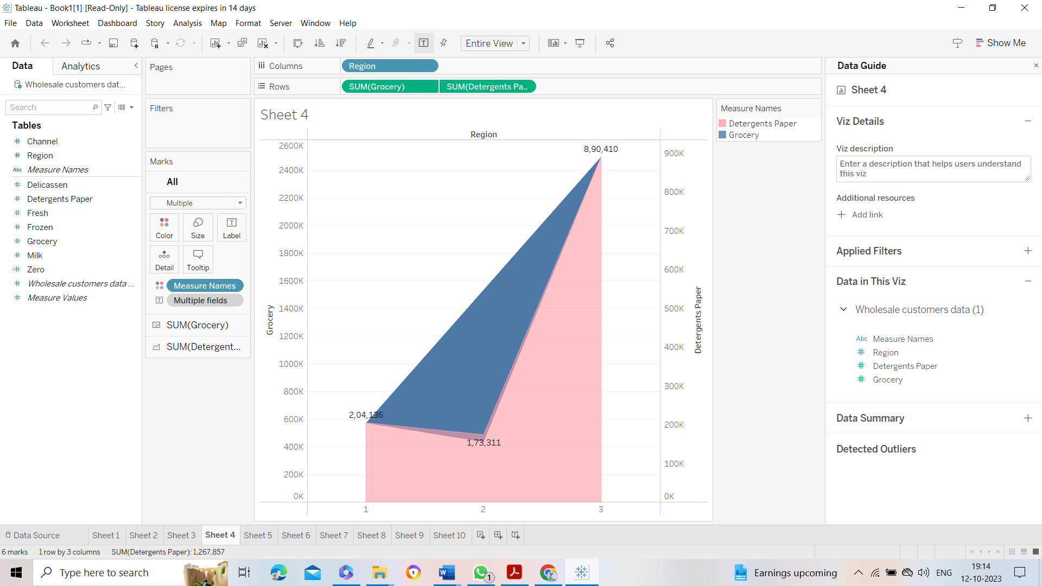
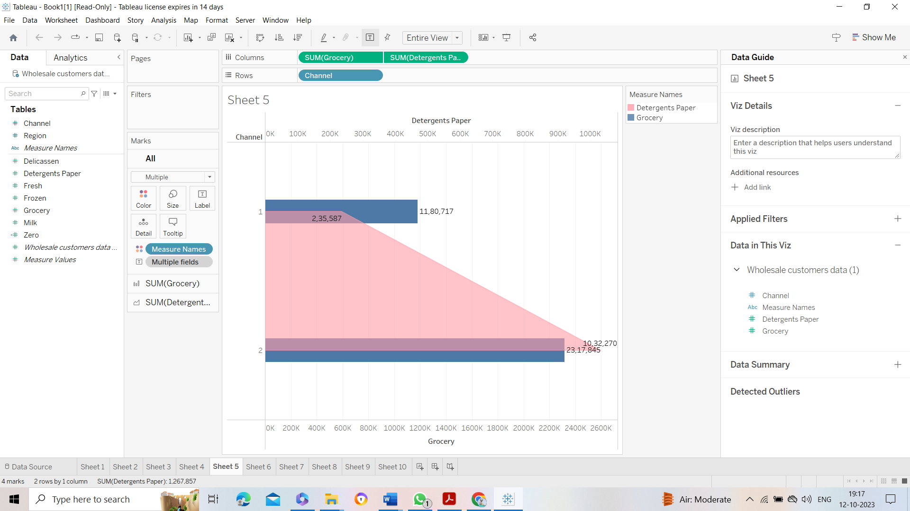

Slide 6
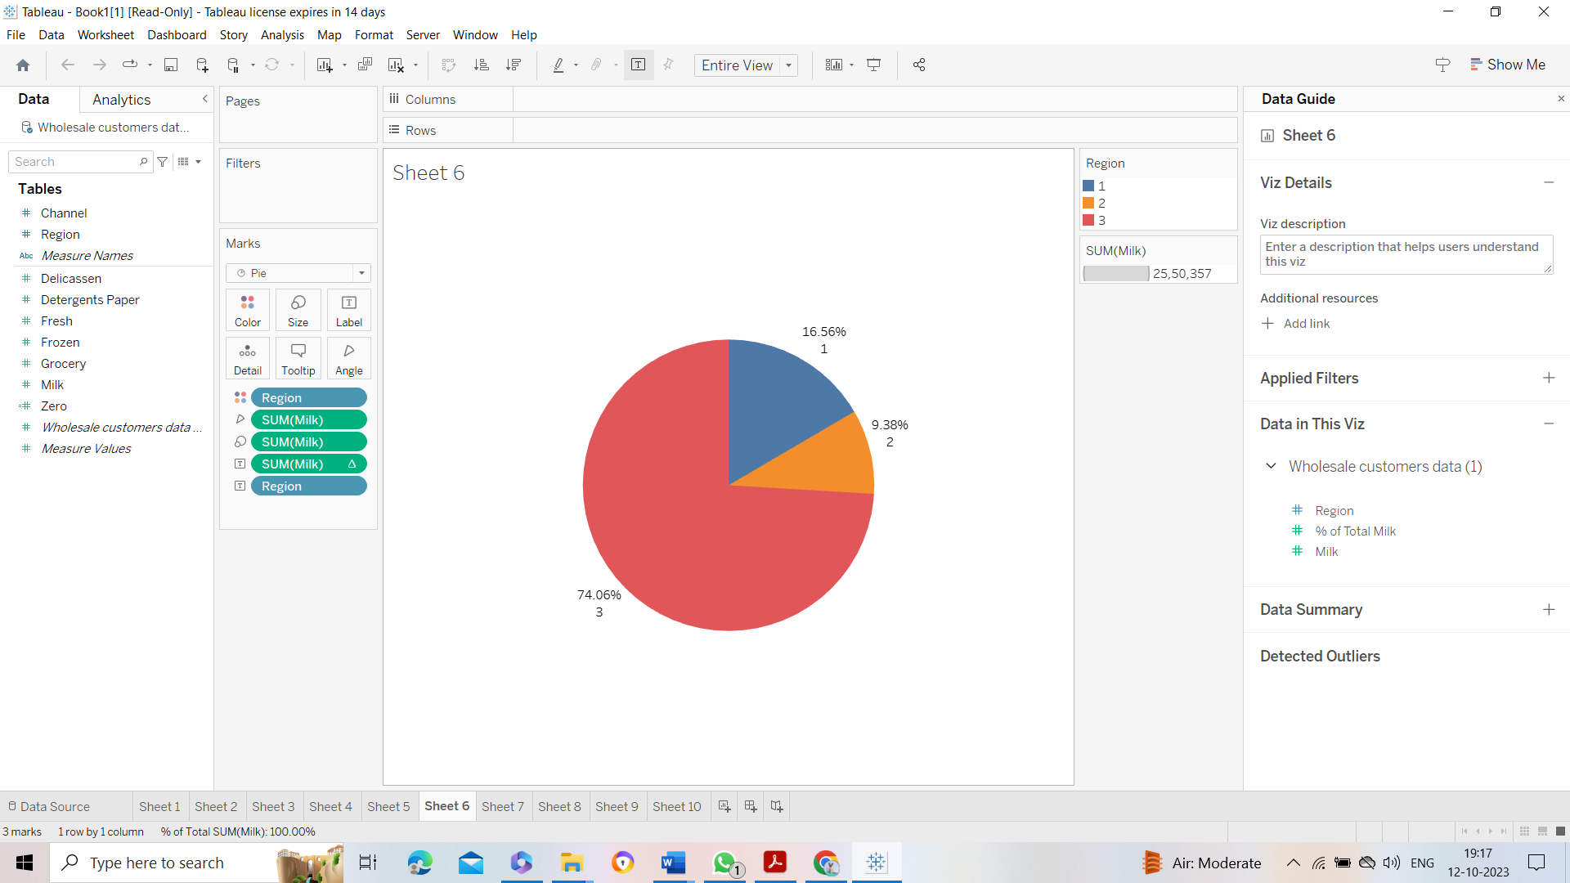
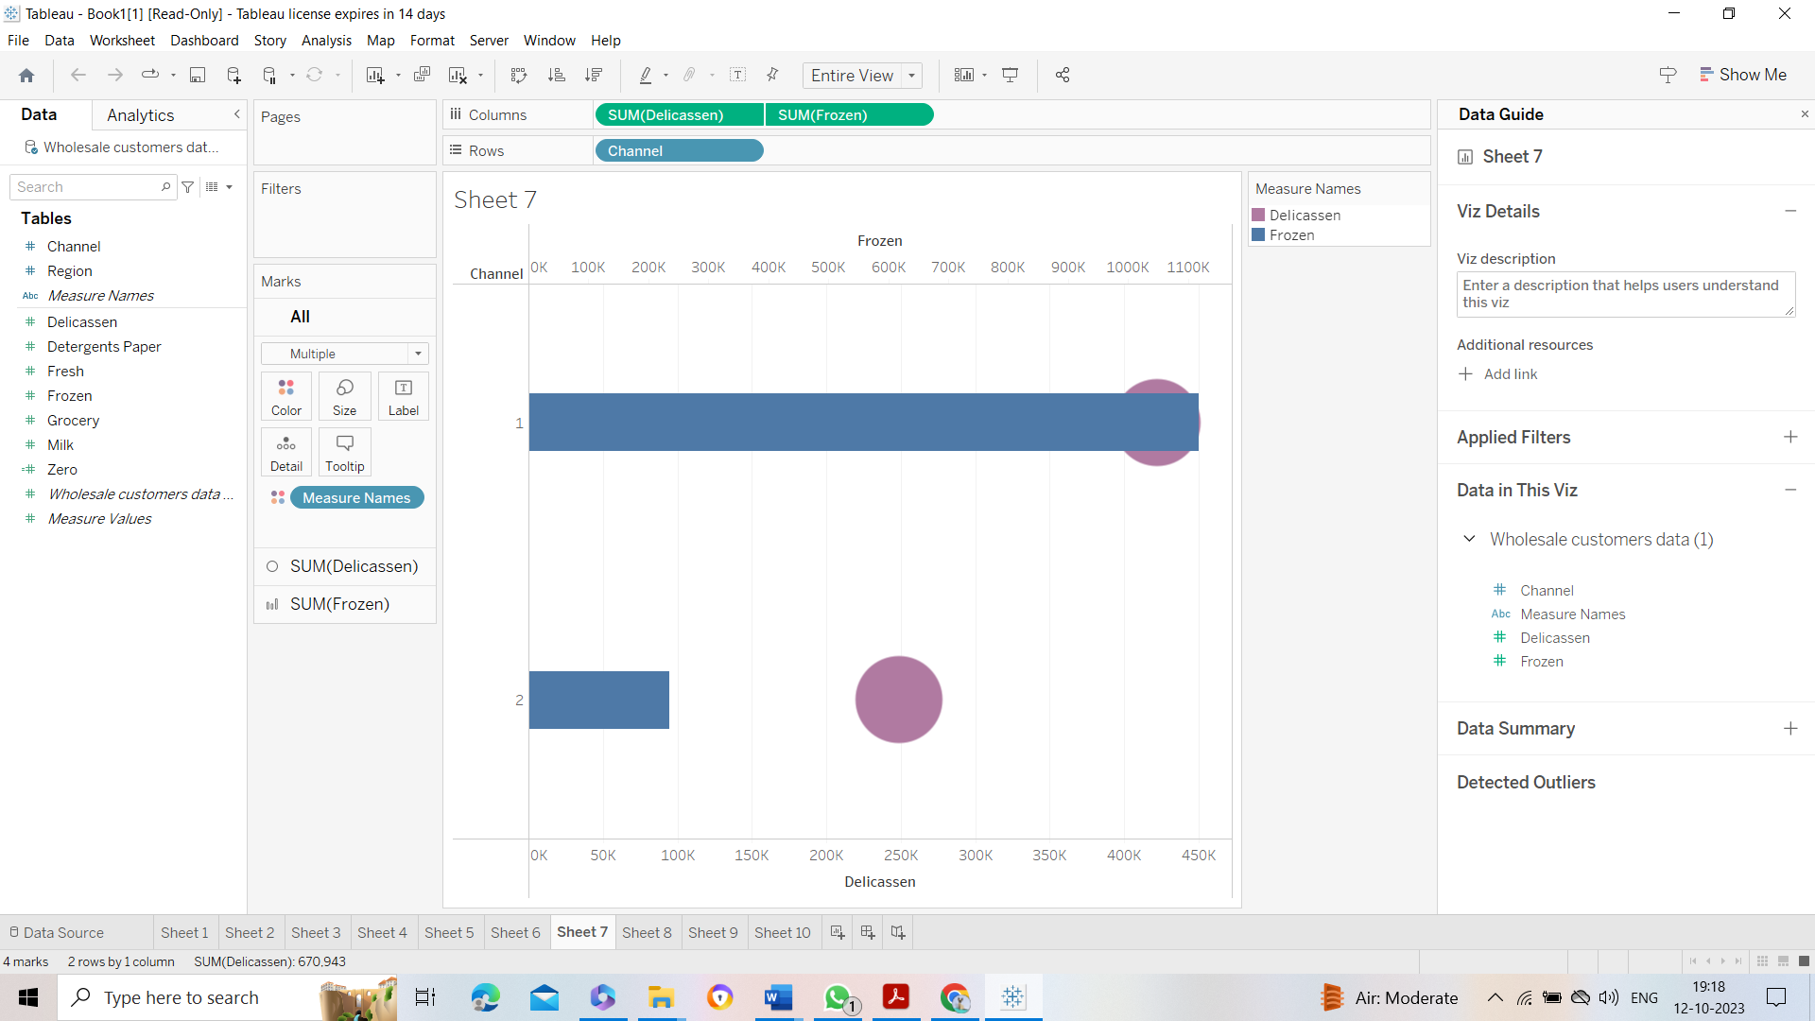
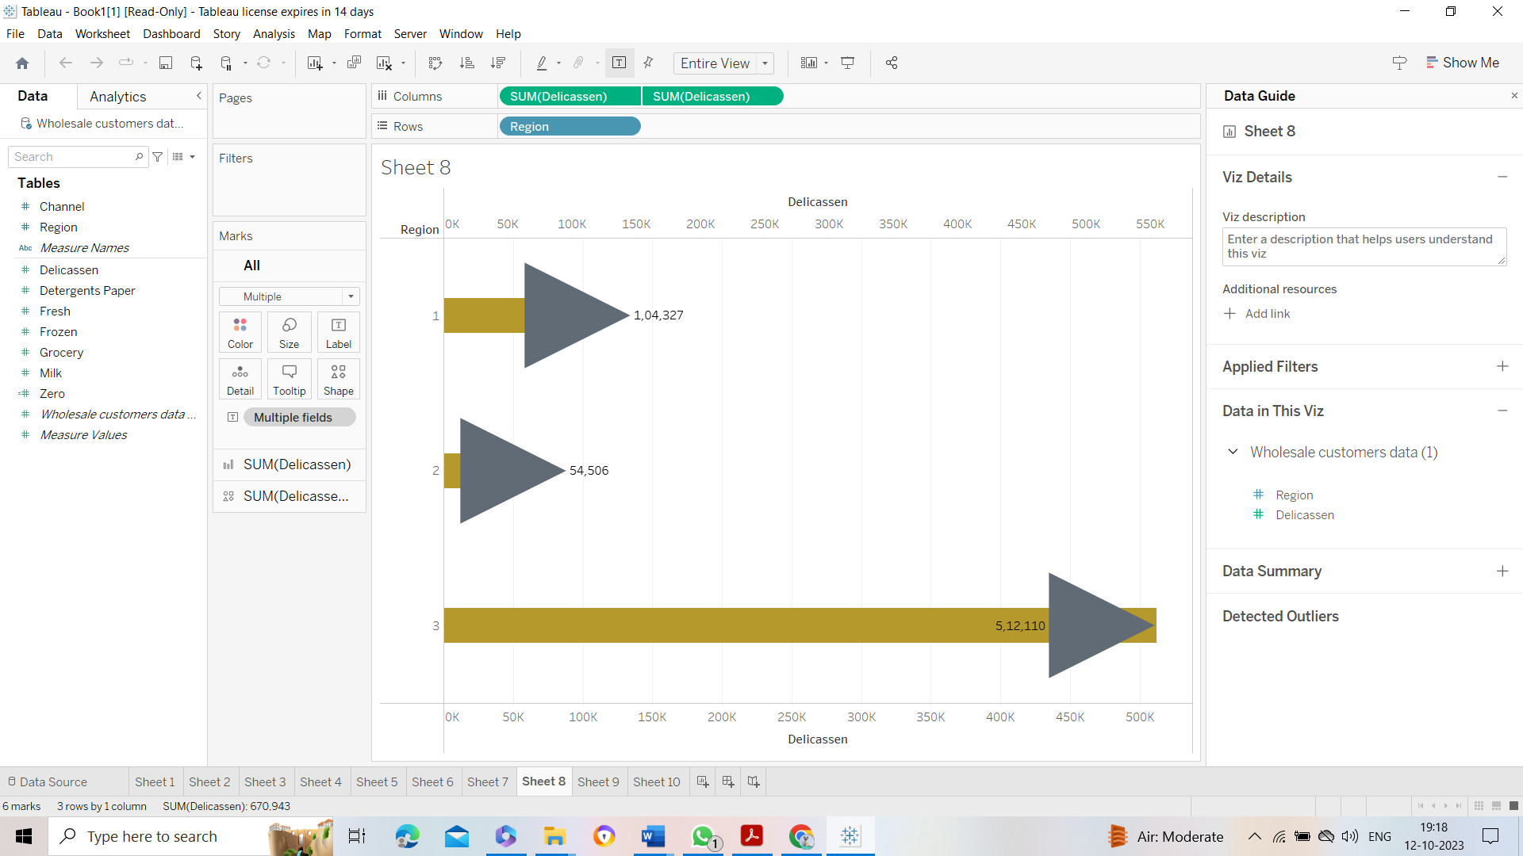

Slide 7
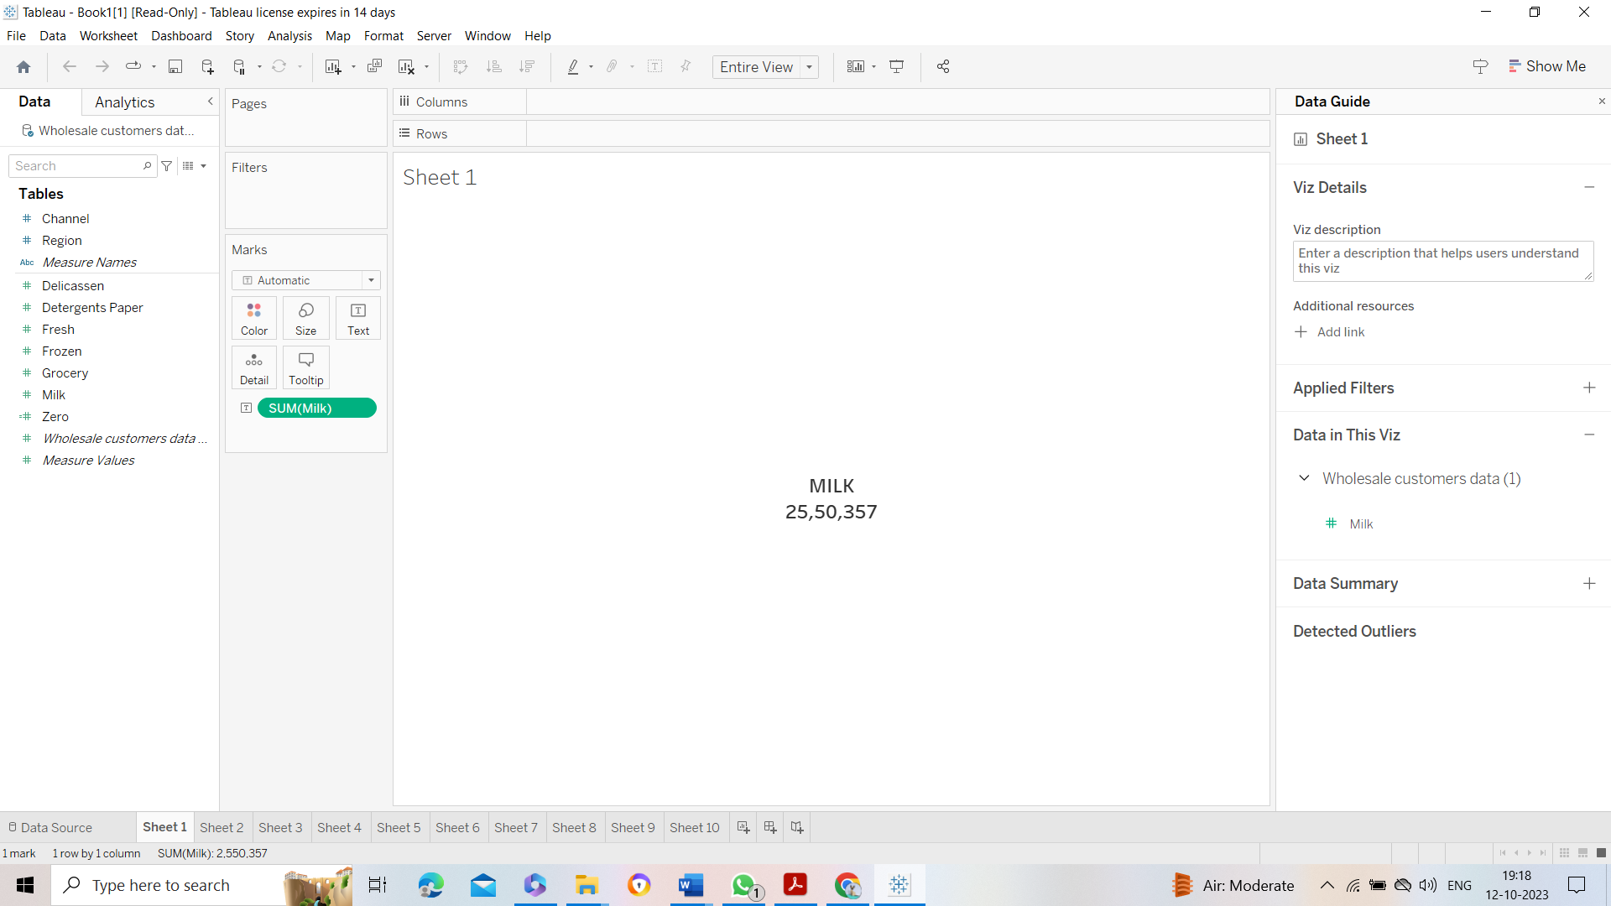
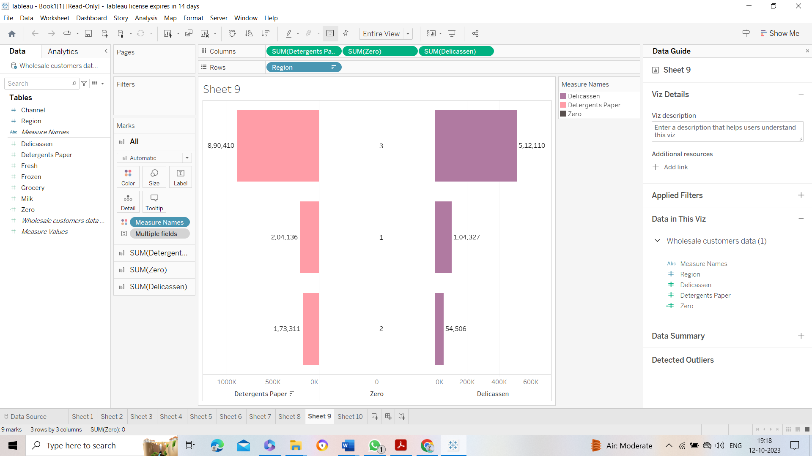
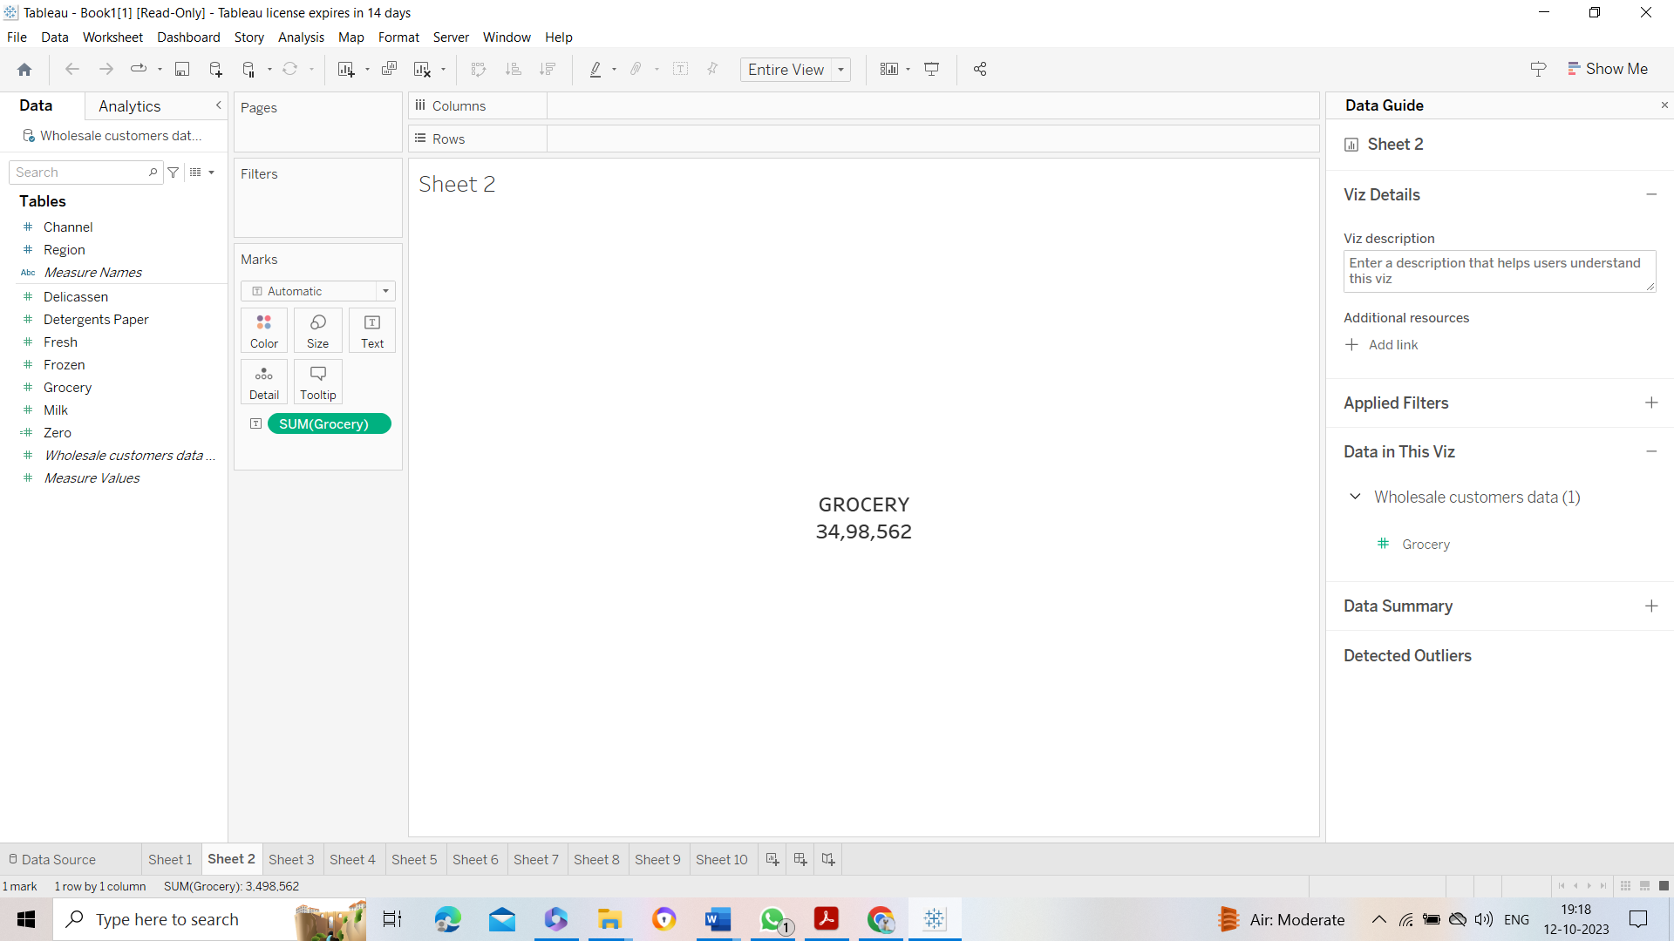
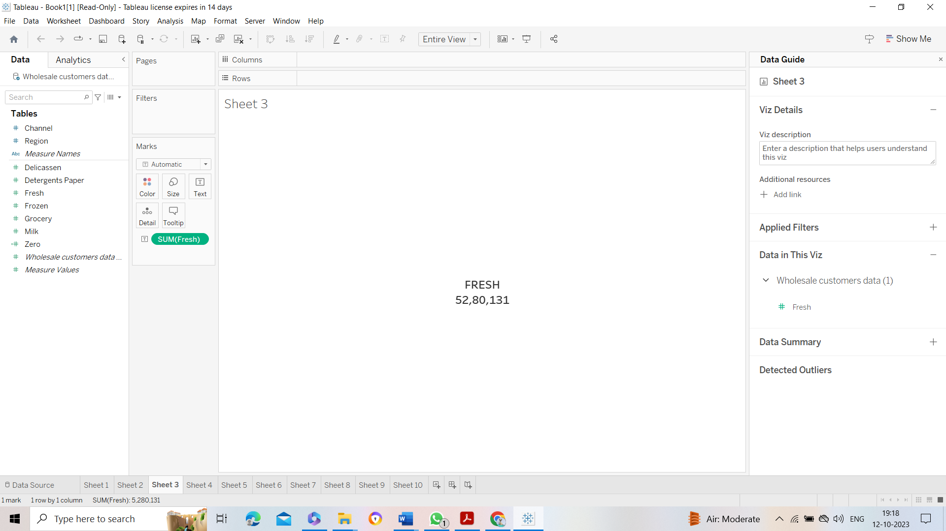

Slide 8
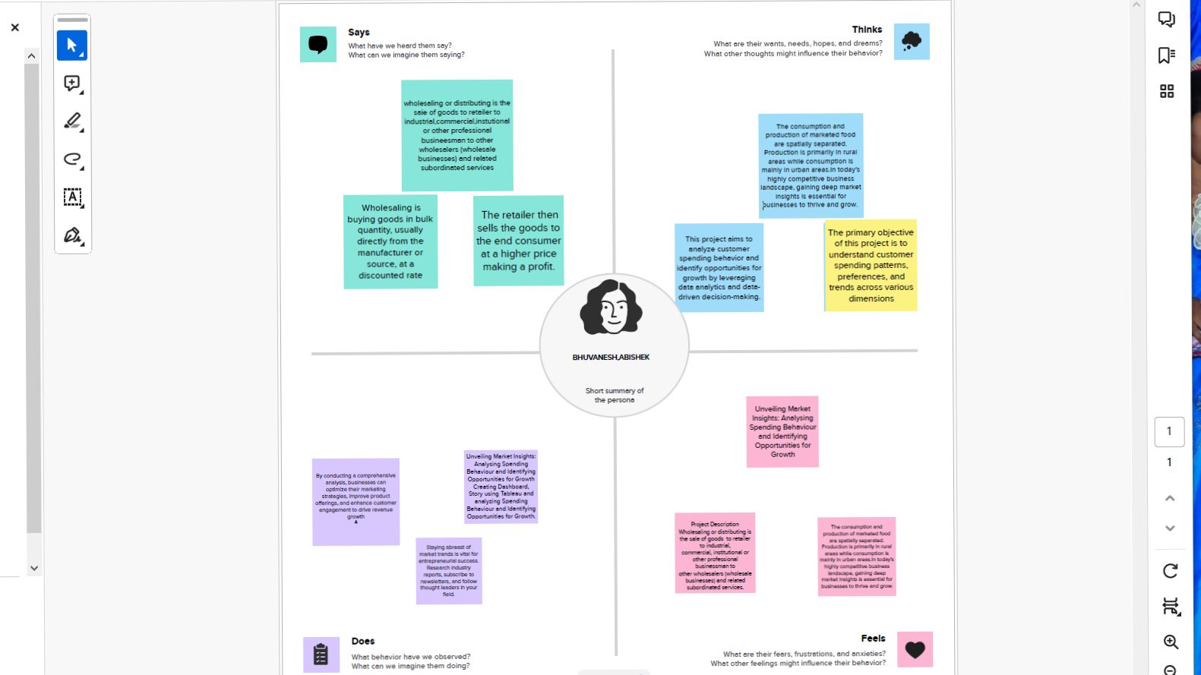

Slide 9
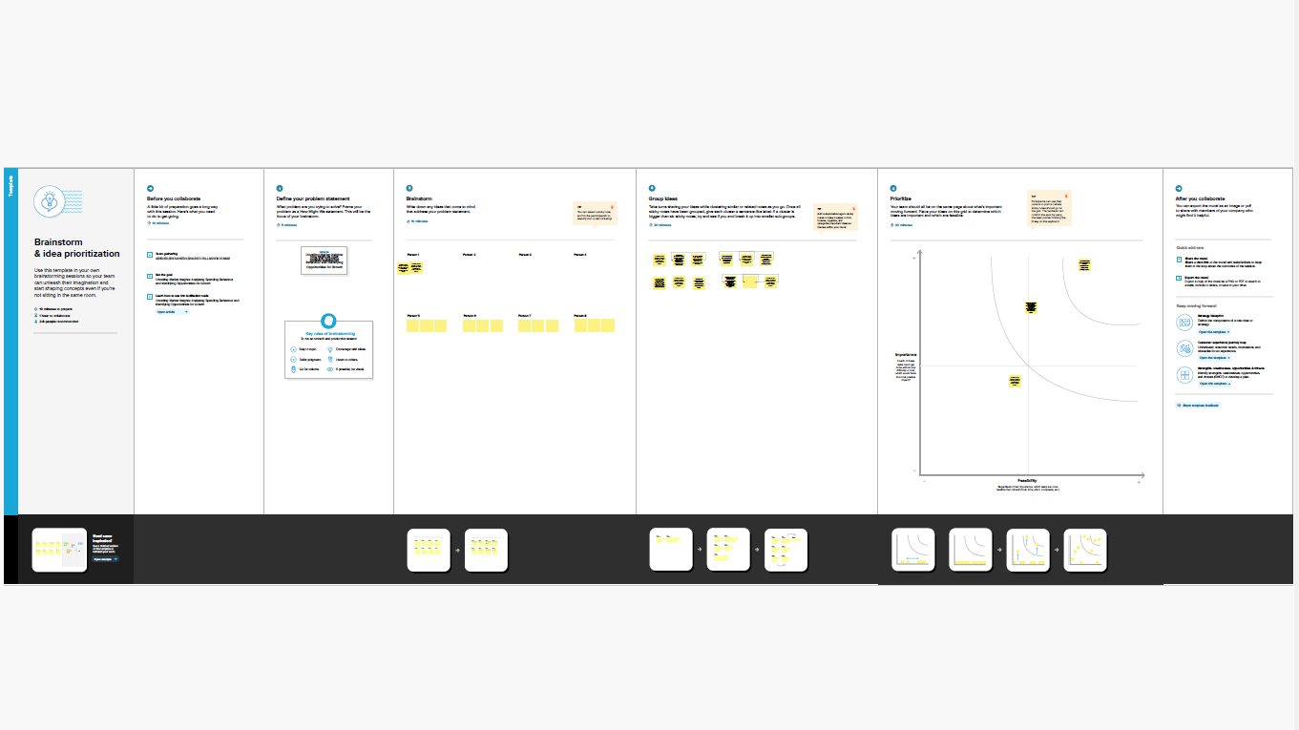

Slide 10
Thank you

